Slide 1
Canada’s Ecozones

Slide 2
Ecozone vs. Natural Regions
Canada has 15 terrestrial and 5 marine ecozones and;
39 unique natural regions
Ecosystems consist of a group of natural regions
Natural regions are areas of the Earth's surface which have similar qualities or attributes

Slide 3
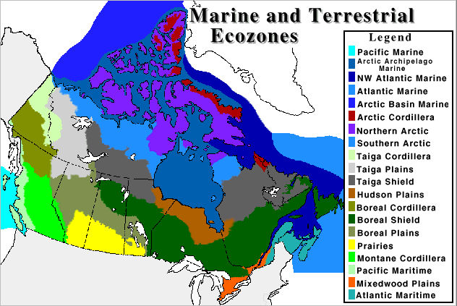
Canada’s Ecozones

Slide 4
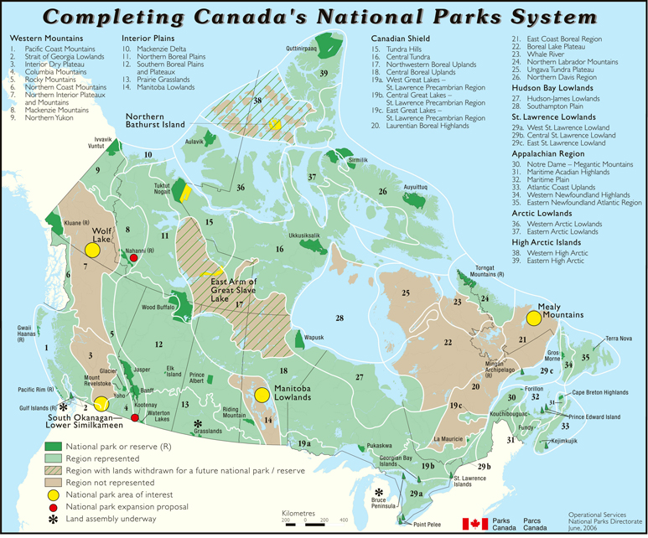
Canada’s Natural Regions

Slide 5
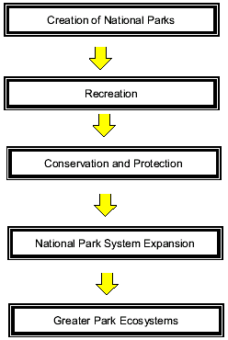
Eras of Canada's National Park System

Slide 6
Parks Canada
responsible for both protecting the ecosystems of natural areas and managing them for visitors to understand, appreciate, and enjoy without damaging their integrity (natural state)

Slide 7
Why are National Parks Created?
to protect and present natural landscapes and natural phenomena that occur in Canada's 39 natural regions.
These parks are located in every province and territory, range from mountains and plains, to boreal forests and tundra, to lakes and glaciers, and much more.
National parks protect the habitats, wildlife and ecosystem diversity of natural regions.

Slide 8
National Parks System Plan
Objective: Our goal is to establish a system of national parks that represents each of Canada's distinct natural regions. This system is just over 60% completed.

