Slide 1
Climate and Weather
What's the difference?

Slide 2
Weather
is the condition of the atmosphere which lasts over a short time period and for a small area
consists of characteristics such as temperature, precipitation, wind, humidity, cloud cover, visibility, and air pressure.

Slide 3
Climate
is the condition of the atmosphere which lasts over a long time period (usually many years) and for a large area.
consists of the same characteristics as weather (such as temperature, precipitation, air pressure, etc.)

Slide 4
What's the difference?
The time period considered - weather describes atmospheric conditions over a few days, or it can change hour by hour, while climate describes conditions over many years (usually 20 years is the standard).
The land area involved- weather is localized (it can be raining in Brampton but sunny in Mississauga) but climate is regionalized (all of Southern Ontario has the same climate).
Climate is "average weather"

Slide 5
Climate or Weather?
The monsoon rains arrive in India
each summer.
Climate
A tornado kills 29 people and destroys
much of a small town in Oklahoma.
Weather
A freak snowstorm drops 50 cm of
snow on parts of southern Ontario.
Weather
The Dust Bowl drought on the
Prairies lasted through most of
the 1930s.
Climate

Slide 6
Climate or Weather?
Temperatures in the north of Canada
are predicted to rise dramatically
due to global warming.
Climate
The long range forecast says
temperatures will fall over the next
two days.
Weather
Thousands die as a result of cyclone
flooding in Bangladesh.
Weather
The long range forecast says snowfall
will decrease significantly in Ontario
ten years from now.
Climate

Slide 7

Climate Terminology
Precipitation
Average Annual Temperature
Temperature Range
Total Precipitation
Continental Climate
Maritime Climate

Slide 8


Precipitation
Any form of water that falls from the sky
Rain
Snow
Freezing
Rain/Sleet
Hail

Slide 9
Factors That Affect Climate
L = Latitude
O = Ocean Currents
W = Wind
E = Elevation
R = Relief
A = Air Masses
N = Nearness to Water

Slide 10
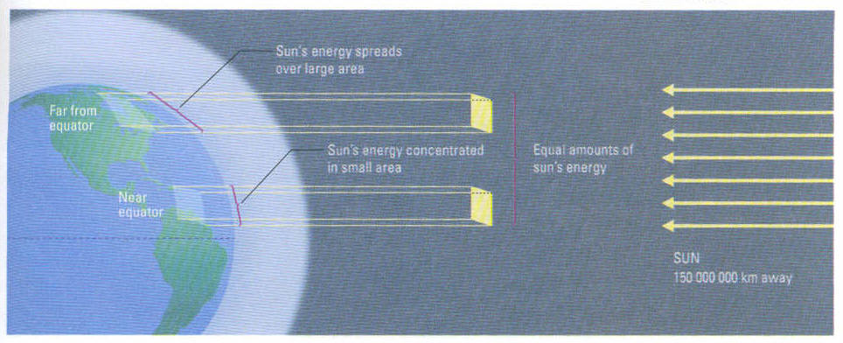
L = Latitude:
The distance (north and south) from the equator (0º).
Regions close to the equator are warmer since direct sun’s rays produce more heat.
Latitude determines if a region is hot or cold

Slide 11
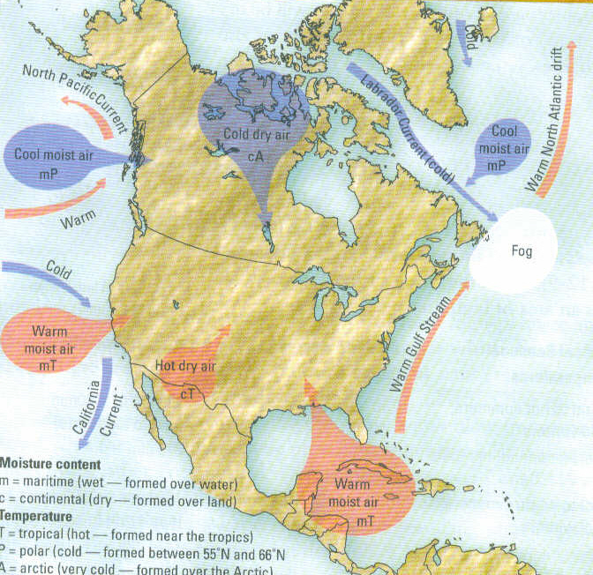
O = Ocean Currents
Ocean currents bring warm or cold water to new places
If the ocean current is warm then it will heat the air above it.
If the ocean current is cold then it will cool the air above it.

Slide 12
W = Wind:
Wind moves hot and cold “air masses” to other parts of the world.
If there is no wind, our weather wouldn’t change very much!

Slide 13
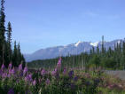
E = Elevation:
Elevation: refers to the height above sea level.
The higher up you
are the colder it feels.

Slide 14
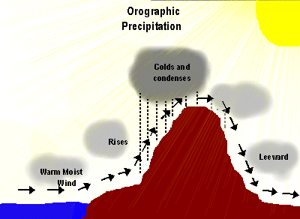
R = Relief:
Relief: refers to land-
Scape and physical features
Such as mountain ranges,
hills and valleys
Mountains act like a
barrier to air masses. As air moves up the mountain it cools condenses and rains. On the other side as it moves down it warms and expands causing dryness or the Rainshadow effect.

Slide 15
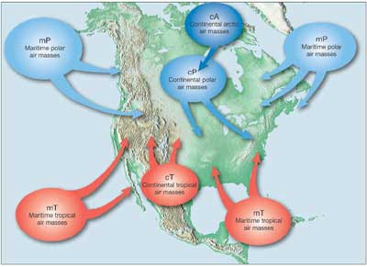
Air Masses
An air mass is a large volume of air with the climate conditions of the area where it is formed.
Air masses originating over oceans contain moisture. Air masses originating over continental locations are dry.

Slide 16
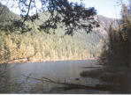
N = Nearness to Water:
Bodies of water have a
moderating effect on land
temperatures
Oceans and lakes heat up and
cool down more slowly than land
masses
In the summer a body of water remains cooler than the land surrounding it. When wind blows, it brings cool air over the land.
In the winter bodies of water retain their heat and are warmer than the land. When wind blows, it bring warm air over the land.

Slide 17
Average Annual Temperature
The overall average temperature for a station tells you how hot or cold the location is in general.
Calculated by adding all the average monthly temperatures and dividing by 12.
For example: Toronto
Adding of all temp. values= 115 115/12=9.6ºC
 | J | F | M | A | M | J | J | A | S | O | N | D
Avg. temp (ºC) | -4.5 | -4 | 0.5 | 8 | 13 | 19 | 22 | 21 | 17 | 11 | 5 | -2
Precip (mm) | 62 | 57 | 66 | 67 | 73 | 63 | 81 | 67 | 61 | 62 | 67 | 64

Slide 18
Temperature Range
Temperature range is the difference between the highest average monthly temperature and lowest average monthly temperature.
It is calculated by subtracting the lowest temperature from the highest temperature.
For example: Toronto
Max. monthly temp: 22 ºC
Min. monthly temp: -4.5 ºC
22-(-4.5)=26.5 ºC temperature range

Slide 19
Total Precipitation
Tells how wet or dry an area is
Calculated by adding all the monthly precipitation values.
For example: Toronto
Adding all the Precip. values together= 790 mm
 | J | F | M | A | M | J | J | A | S | O | N | D
Avg. temp (ºC) | -4.5 | -4 | 0.5 | 8 | 13 | 19 | 22 | 21 | 17 | 11 | 5 | -2
Precip (mm) | 62 | 57 | 66 | 67 | 73 | 63 | 81 | 67 | 61 | 62 | 67 | 64

Slide 20
Continental Climates
In Canada, land areas that are far away from
the ocean are generally very cold and dry in the
winter and very hot and dry in the summer.
This is called "Continental Climate".
Large temperature range (more than 25ºC)
Low total precipitation (less than 1000 mm yearly)
Receive more precipitation in the summer months than the winter months.

Slide 21
Maritime Climates
Large bodies of water have a moderating effect on the land nearby because the water takes a long time to heat up in the summer and a long time to cool off in the winter. The temperature of the water affects the temperature of the land.
Areas near large bodies of water have cool, moist winters and warm, moist summers. This is called "Maritime Climates"

Slide 22
Maritime Climates
Low temperature range (less than 25ºc)
High total precipitation (more than 1000 mm)
More precipitation in the winter months than the summer months.

Slide 23
Great Lakes Climate
Areas near the Great Lakes are partially "Continental" and partially "Maritime" because they have cold, moist winters and hot, moist summers.
Temperature Range high
Medium total precipitation
Precipitation year round

Slide 24
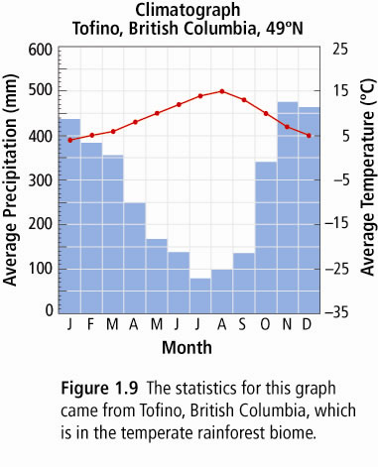

Slide 25
Climate Graphs
Maritime-Vancouver
Continental-Winnipeg

Slide 26
Climate Graphs
Great Lakes climate
Precipitation all year
Large temperature range

