Slide 1
Forestry
Task: Brainstorm different uses for forests
recreation
habitat
Lumber
Canada’s Forests
Food
Clean air
Hiking
Paper

Slide 2
So….why are trees important to Canada?
Task: Drag and drop brainstorm ideas
Economic | Social | Environmental

Slide 3
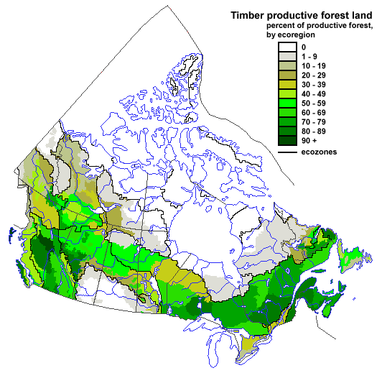
Where does forestry occur in Canada?
Quebec
Ontario
New Brunswick
British Columbia

Slide 4
Methods of Harvesting Forests
Clear-cutting
Shelterwood Cutting
Selective cutting

Slide 5
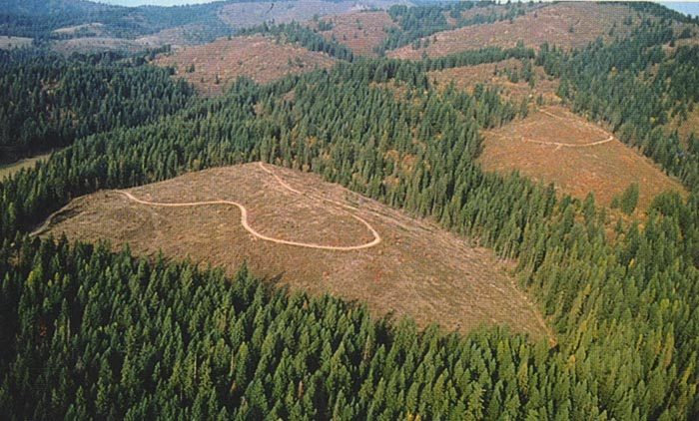
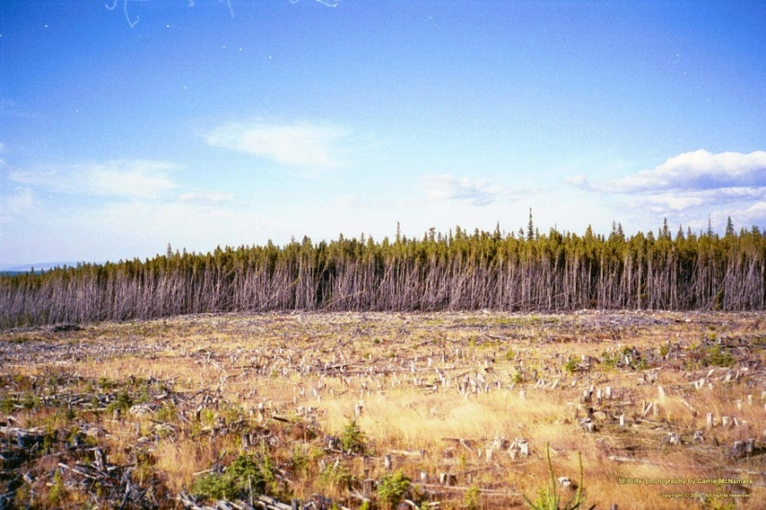
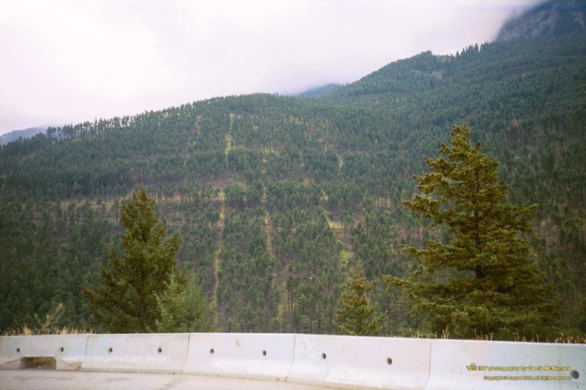
Methods of Harvesting Forests
Clear Cutting
Loggers remove every tree and leave a barren landscape.
When replanted, the new forest grows uniformly in species and size

Slide 6
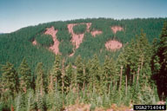
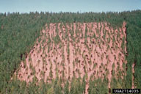
Methods of Harvesting Forests
Shelterwood Cutting
Involves clear-cutting only part of an old growth forest
Small groups of seed bearing trees are left so the area will regenerate.
Shelterwood method is often used in forests that have grown and aged evenly

Slide 7
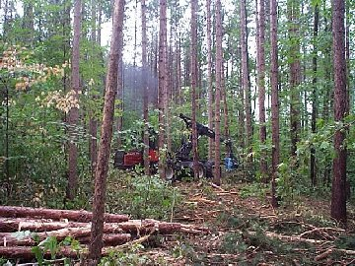
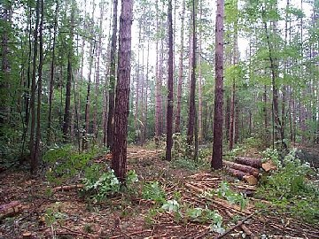
Methods of Harvesting Forests
Selective Cutting
Only mature trees of the desired size, type or quality

Slide 8
Selective or Clear-cutting?

Slide 9
Selective or Clear-cutting?

Slide 10
Selective or Clear-cutting?

Slide 11
Forestry (cutting down trees)
Advantage Disadvantage

Slide 12
Why are trees important in Canada?
PROFIT
PEOPLE
PLANET

Slide 13
PROFIT
Forest
Sector
Revenues: $57.1 Billion
500 times more than Justin Bieber’s net worth
3000 times Lebron James’ salary

Slide 14
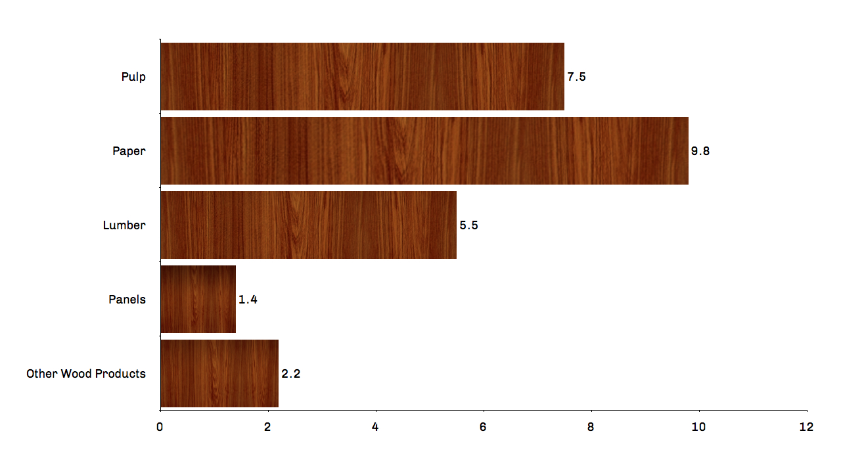
$ Billions (CAD)
- In Eastern Canada, pulp and paper product manufacturing is most common
- In Western Canada, wood product manufacturing is most common
Source: FPAC

Slide 15
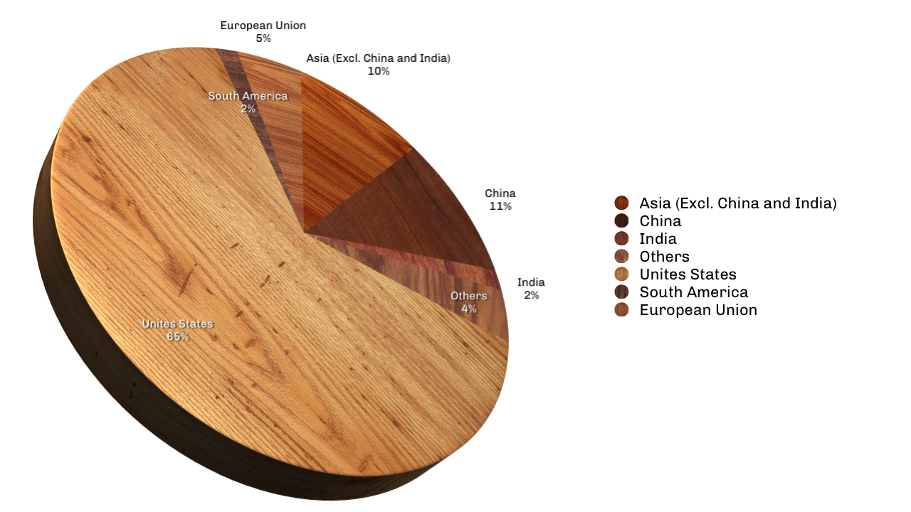
Source: FPAC

Slide 16
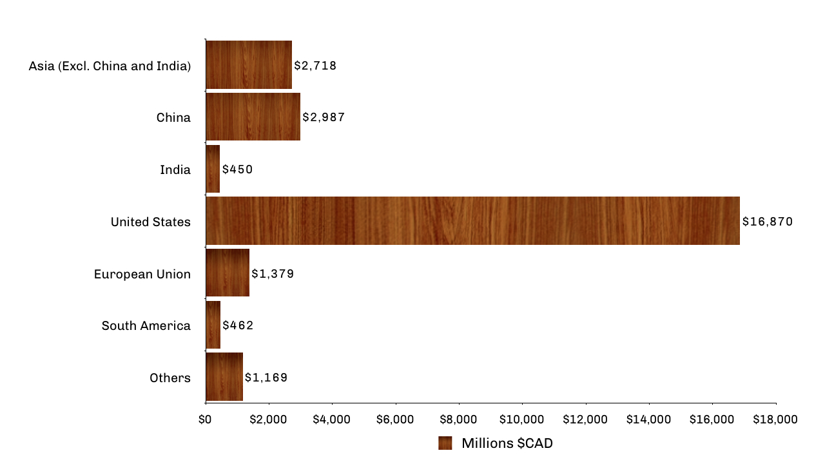
Source: FPAC

Slide 17
PEOPLE
http://www.fpac.ca/index.php/en/page/economic-backbone
- Quebec, Ontario and British Columbia have the greatest numbers of forest workers.
- The Atlantic Provinces, Quebec and British Columbia are the most forest-dependent regions, with a large share of their economy based on the sector

Slide 18
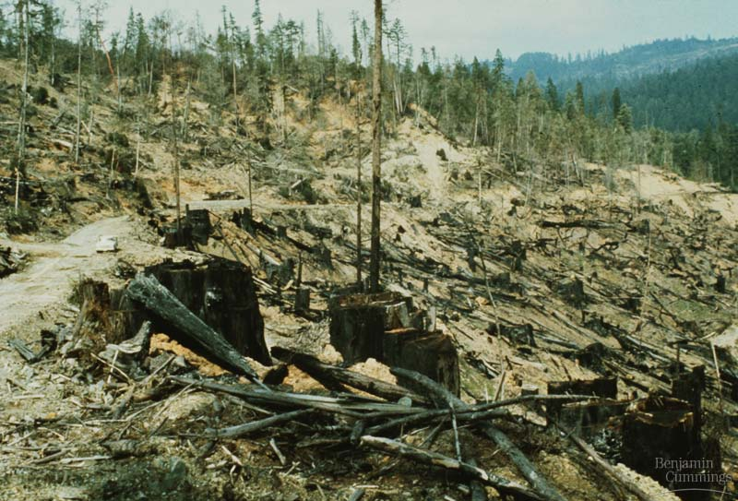
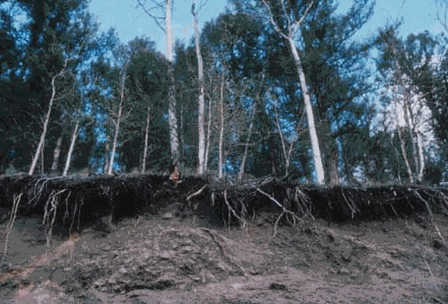
PLANET
Forestry Issues
Too few trees are replanted?
= Soil erosion

Slide 19
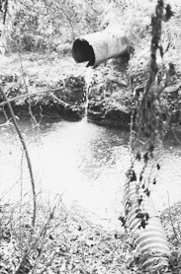
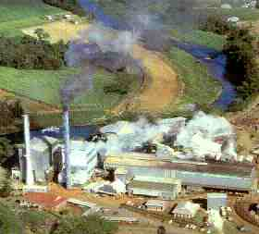
Forestry Issues
Water Pollution
Air Pollution

Slide 20
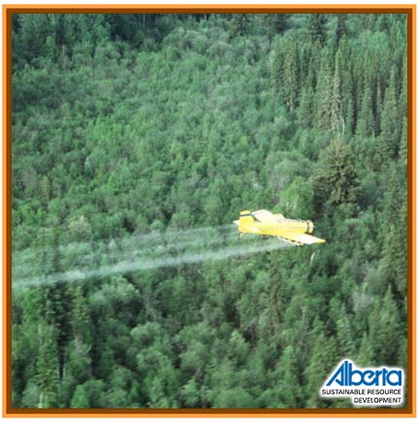
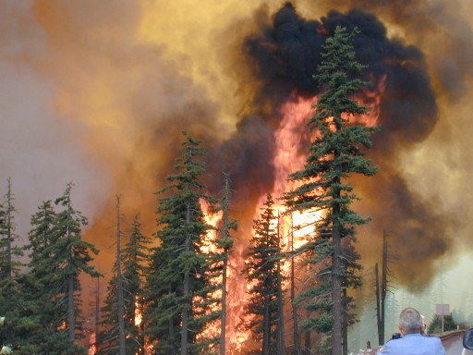
Forestry Issues
Aerial Spraying
Forest Fires

Slide 21
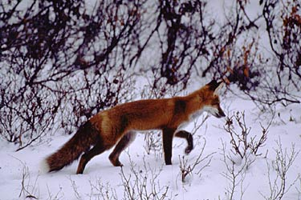
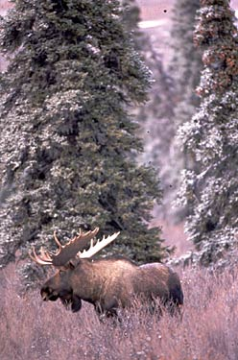
Forestry Issues
Destruction of Wildlife Habitat

Slide 22
Summary:
 | Economy | Social | Environment
Positive Impact
Negative Impact
Something Interesting
(PROFIT)
(PEOPLE)
(PLANET)
TASK: Complete the table using information from 3 sources:
Source 1: Textbook
Source 2: Forest Products Association of Canada http://www.fpac.ca/index.php/en/page/economic-backbone
Source 3: Alberta Agriculture and Rural Development http://www1.agric.gov.ab.ca/$department/deptdocs.nsf/all/agdex3489

Slide 23
 | Economy | Social | Environment
Positive Impact
Negative Impact
Something Interesting
(PROFIT)
(PEOPLE)
(PLANET)

