Slide 1
Natural Resources Game

Slide 2
Minds On: Each table represents a society
Number the people in your group: 1, 2, 3, 4
Your society has moved to a new piece of land
Your paper = land on which your society will settle
Each corner of the page has a different resource:
Draw natural resources for building shelter
Draw a landform that will help you hide or defend yourself from an enemy. (a place for a lookout)
A source to gather, grow or hunt for food.
Draw source of fresh water.

Slide 3
Making Decisions
Your culture has to pick 1 site (corner) in which to settle:
What are the advantages of each site?
What are the disadvantages of each site?
Where would you locate your FIRST settlement? (you can only choose ONE)
Draw 1 road connecting two sites—where will it go?

Slide 4
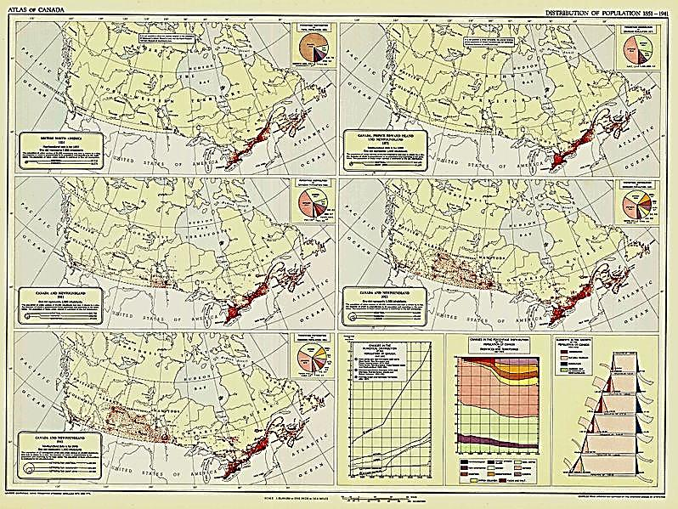
What did the Europeans choose in Canada?
Canada - 1851

Slide 5
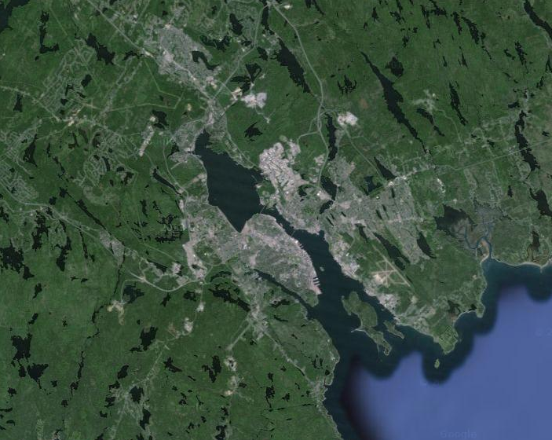
What did the Europeans choose in Canada?
Halifax

Slide 6
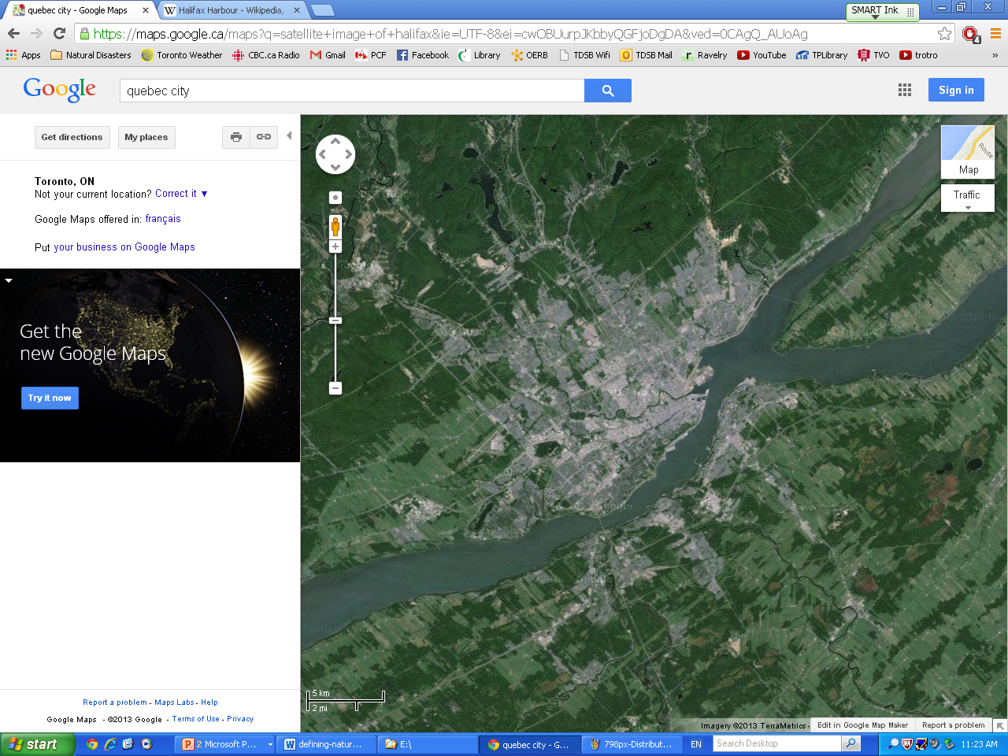
What did the Europeans choose in Canada?
Quebec City

Slide 7
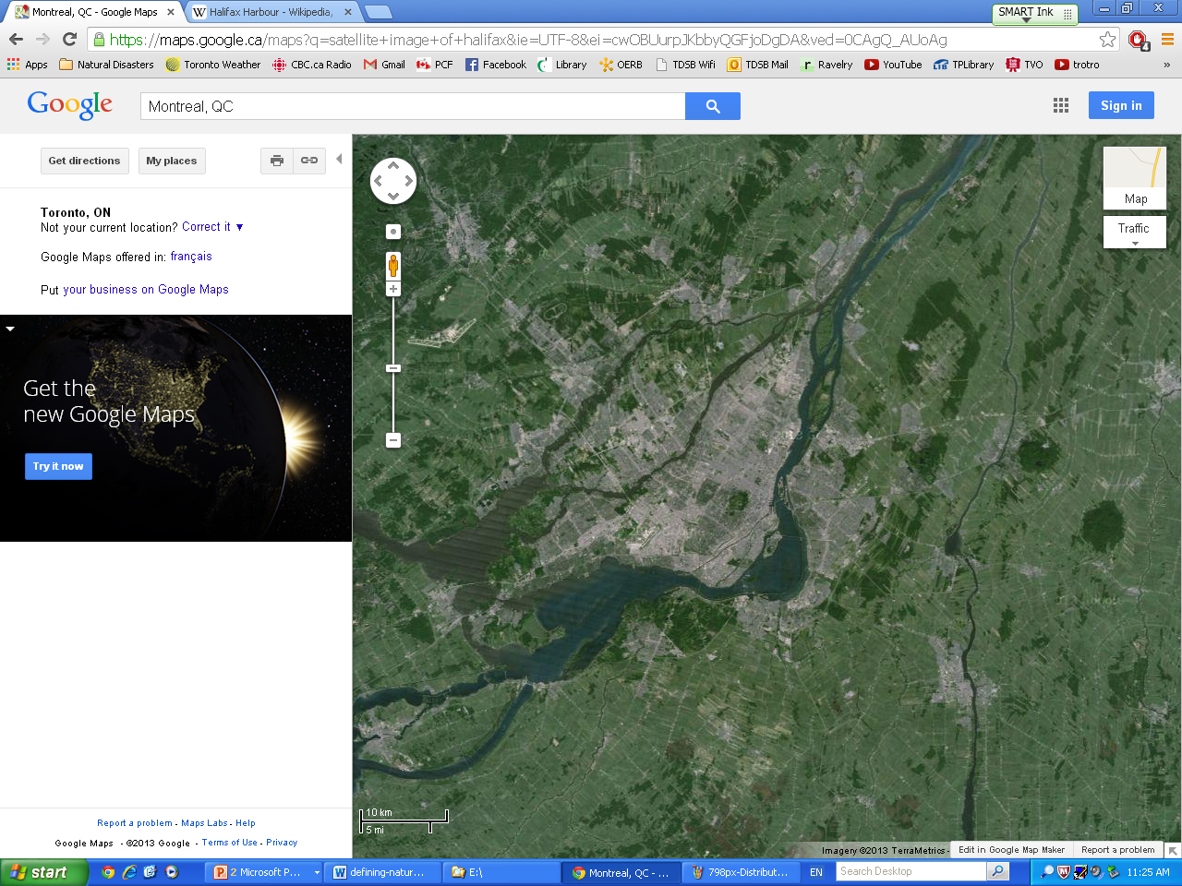
What did the Europeans choose in Canada?
Montreal

Slide 8
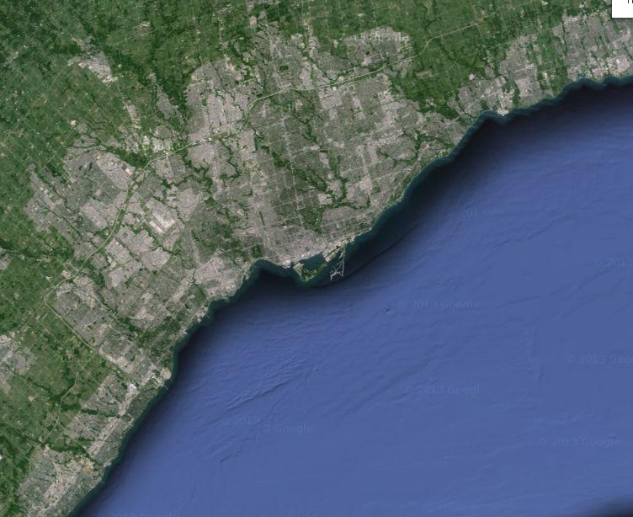
What did the Europeans choose in Canada?
Toronto

Slide 9
What’s the Big Idea?
When humans make plans to settle they have to consider:
  where they will get food, shelter, water
  how far they will have to walk, travel
Question: What resources does Canada have that meet human needs?

Slide 10
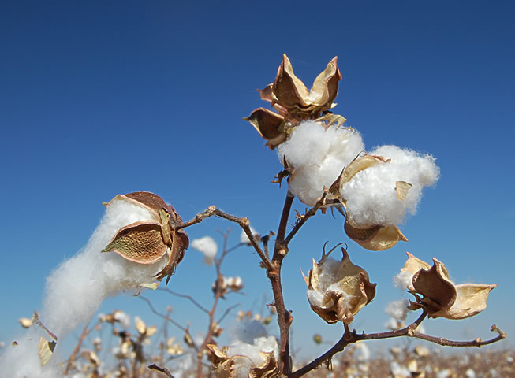
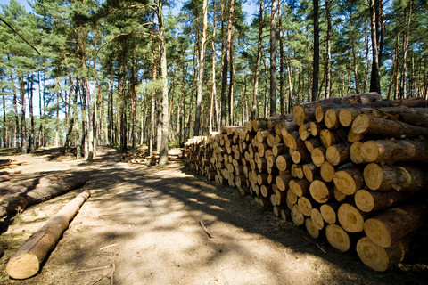
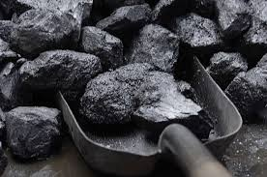
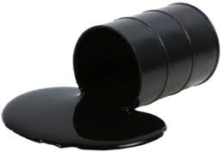
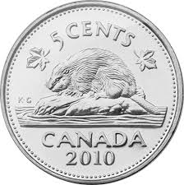
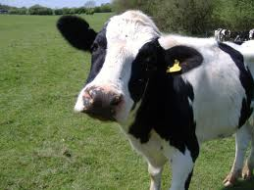
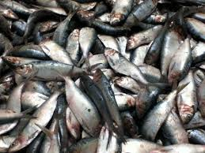
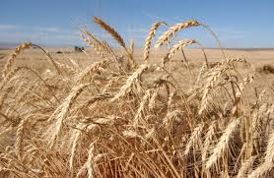
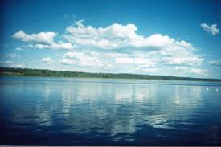

Slide 11
Natural Resources
What is a natural resource? Read the statements listed below. Only TWO of them apply to ALL natural resources. Try to pick out the correct TWO and use them to write a simple definition of a natural resource.
“is mined”
“occurs naturally in the environment”
“is manufactured” “is not alive”
“is found in Canada” “is used by people”
“is limited in quantity” “produces pollution”

Slide 12
Primary Producers
ore (metal)
crops
trees, fish
primary producers:
  people + organizations that work with natural resources
  grow harvest extract
most products from primary industry are considered raw materials
  they go on to be made into something else

Slide 13
Natural Resource
Industry
Fish
Plants and Animals
Metals and Minerals
Trees
Fishery
Agriculture
Mining
Forestry

Slide 14
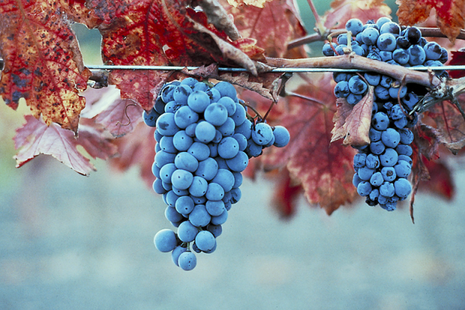
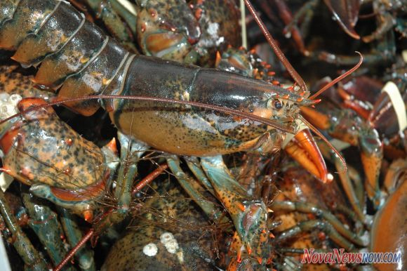
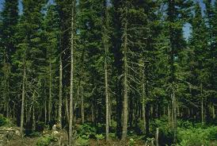
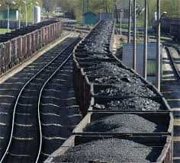
Canada’s major primary industries are:
  agriculture
  fishing
  forestry
  mining

