Slide 1
The Ice Age
CGC 1D1
Mr. Zapfe

Slide 2
Cenozoic Era
Final changes occurred which gave Canada’s landforms their present shape
Continuing collision of North American and Pacific Plates completed the formation of the Rocky Mountains
During the last 2 million years, Canada and much of the world experienced an Ice Age

Slide 3
Cenozoic Era Continued
Ice sheets cover much of North America
Human beings develop
Age of mammals
Modern forms of life evolve

Slide 4
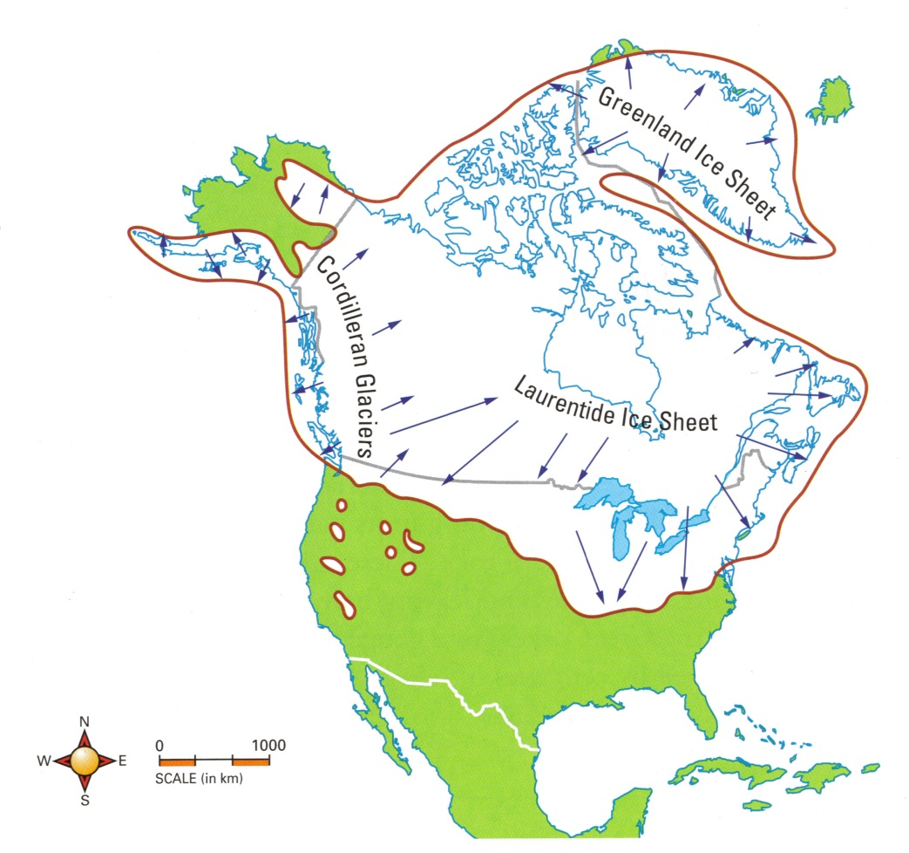
Ice Age
Period of time when freezing temperatures created ice sheets across the continents

Slide 5
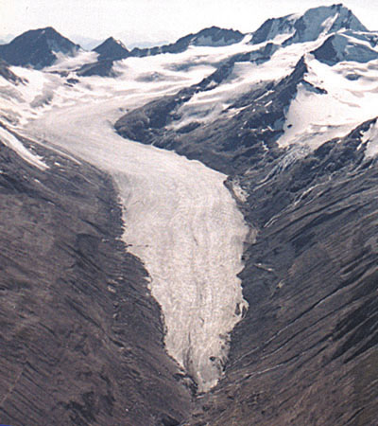
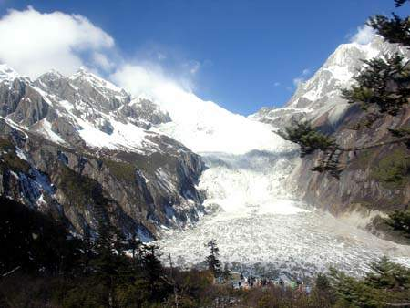
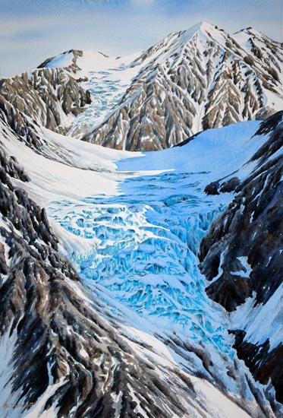
Ice Age
The ice age created huge masses of ice called glaciers
As glaciers moved, their actions were like giant earth-moving machines, scraping and gouging the land they covered

Slide 6
Effects of Glaciation
Like the forces of erosion, the movement of glaciers carves and gouges the landscape, but also deposits sediments of clay, silt, sand and gravel to form a variety of depositional features
Because this happened recently (in geologic time) glaciation has had an enormous effect on Canada’s geography setting the current pattern of rivers, hills and plains

Slide 7
Types of Glaciers
Alpine Glaciers
Glaciers found in mountainous regions
Move from areas of high elevation to low elevation under the force of gravity
Movement usually only a few cm a year
Continental Glaciers
Glaciers that spread out to cover a large portion of the continent
Move under their own weight

Slide 8
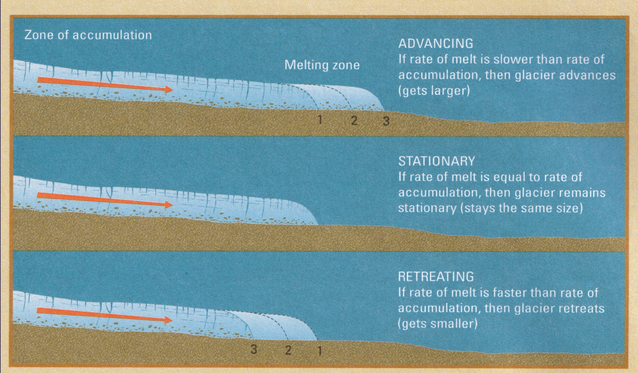
Types of Glaciers Continued
Advance or retreat of a glacier is determined by the balance between ice build-up and ice melt

Slide 9
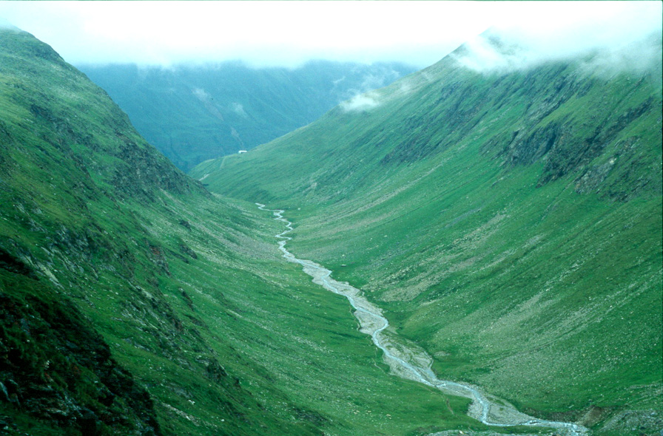
Erosional Features Created By Glaciers
U-Shaped Valleys
Notes:
Jasper Alberta

Slide 10
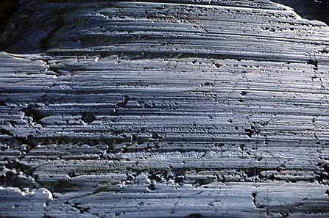
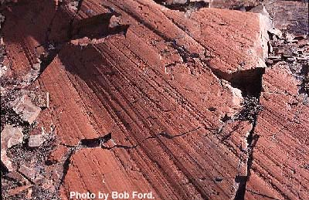
Striations
Notes:
Indian Peaks, Utah

Slide 11
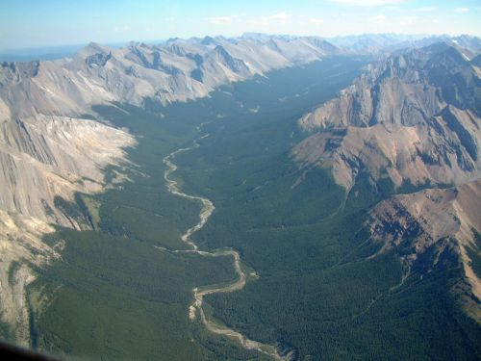
Glacial Spillways
Notes:
Jasper Alta

Slide 12
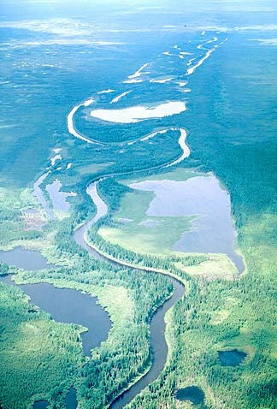
Misfit Streams
Notes:
Sachigo River, ON

Slide 13
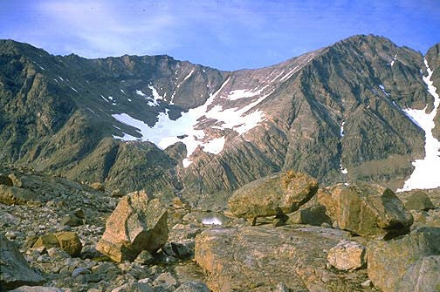
Cirques and Alpine Glacial Features
Notes:
Labrador

Slide 14
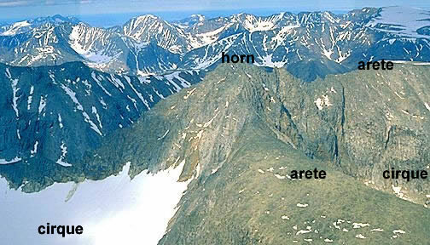

Slide 15
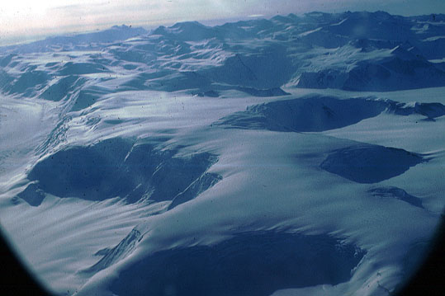
Notes:
Antarctic Cirques

Slide 16
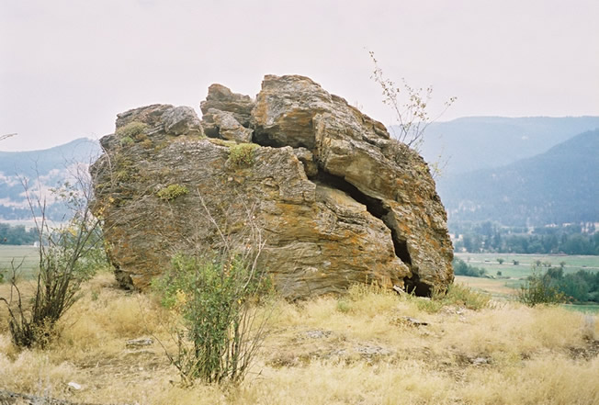
Depositional Glacial Landforms
Glacial Erratics
Notes:
Vernon BC

Slide 17
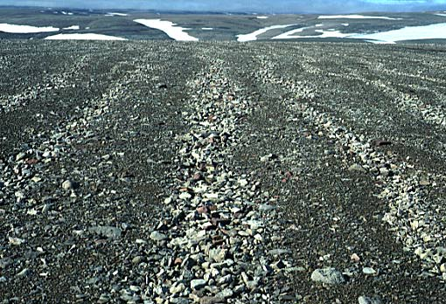
Glacial Till and Till plains

Slide 18
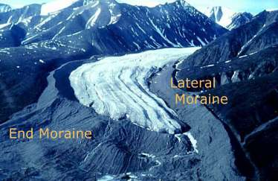
Moraines

Slide 19
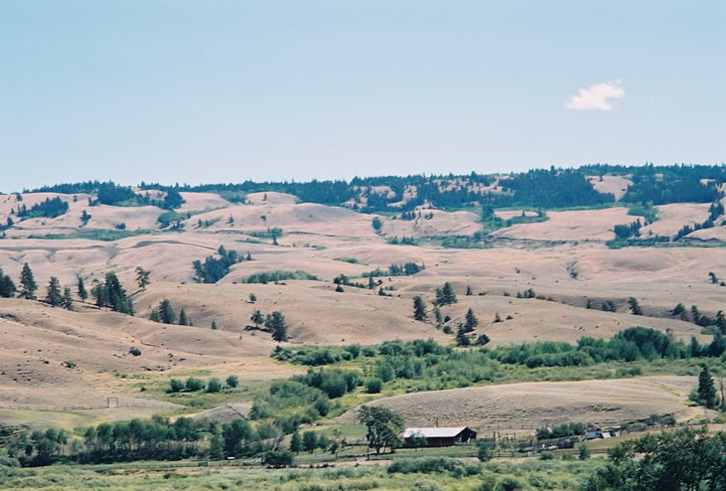
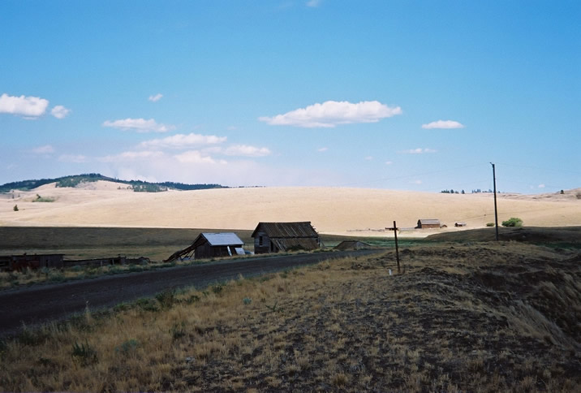
Drumlins
Notes:
Near Kamloops BC

Slide 20
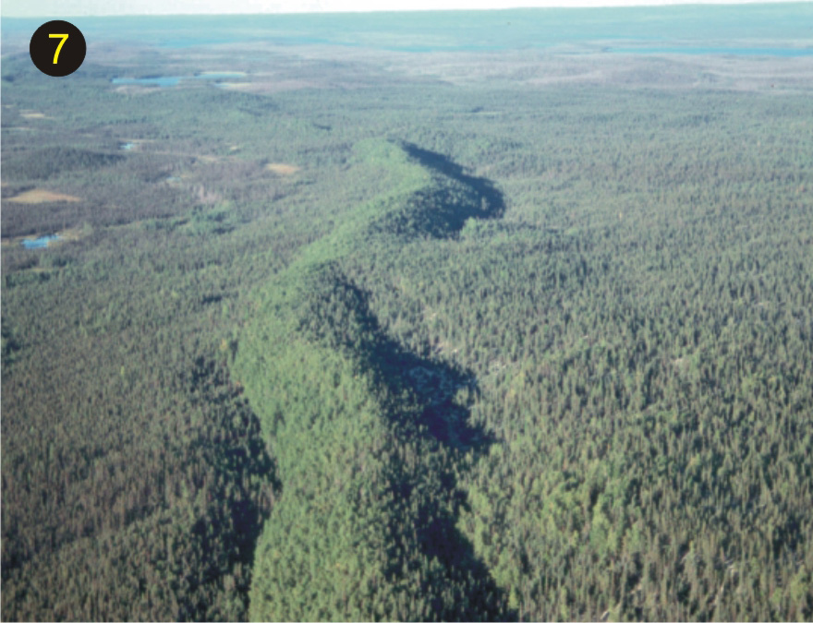
Eskers

Slide 21
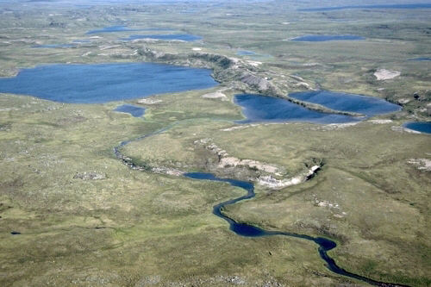
Kettle Lakes
Notes:
Nunavut

