Slide 1
Volcanoes and Mountain Forming

Slide 2
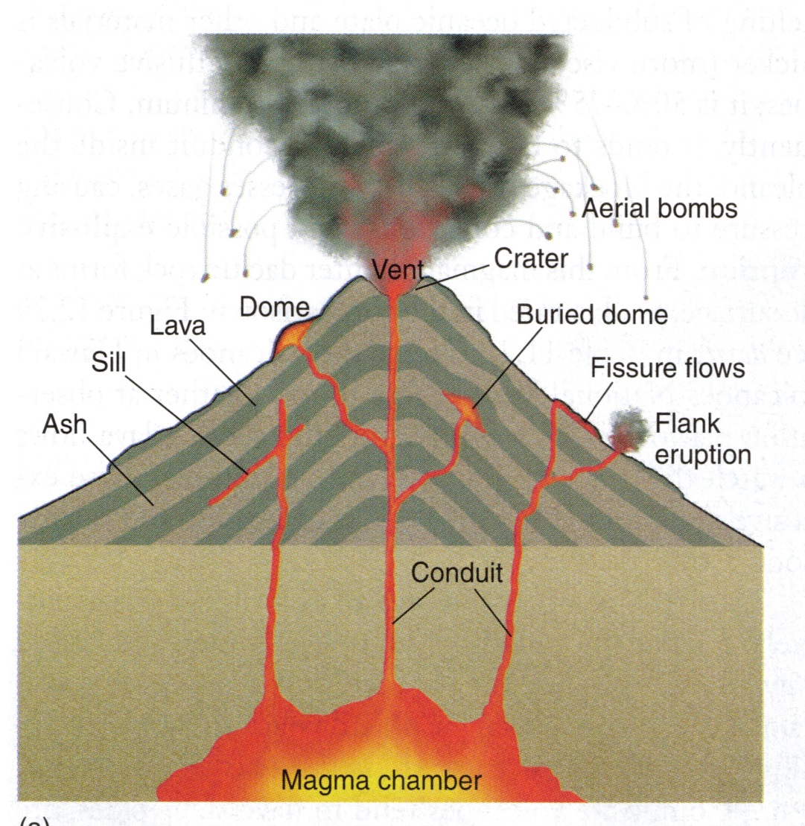
Volcanoes
Formed by “hot spots” in the Earth’s core. Rising heat sets the molten material of the mantle into huge circular motions
As convection currents
swirl, they drag pieces of
the lithosphere up with
them
Cracks open along plate
edges and magma forces
its way through
Notes:
Play volcano forming video, insert diagram of volcanoes: pg390 geosystems

Slide 3
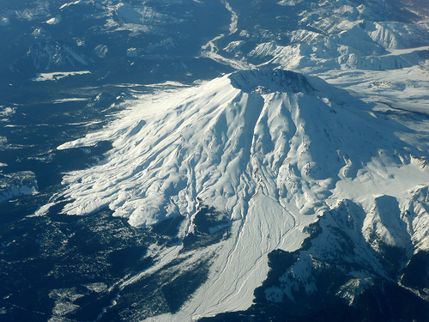
Mount St. Helens
Notes:
Insert photos of major volcanoes

Slide 4
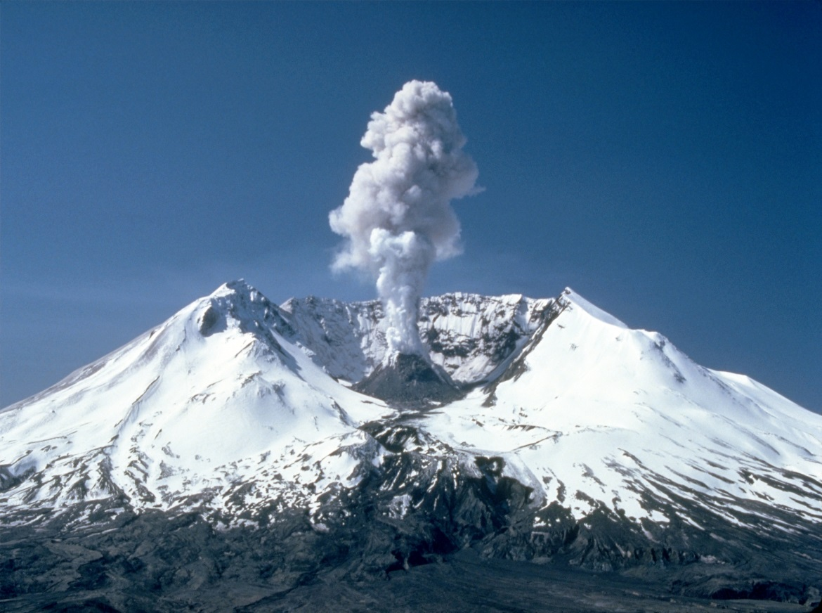
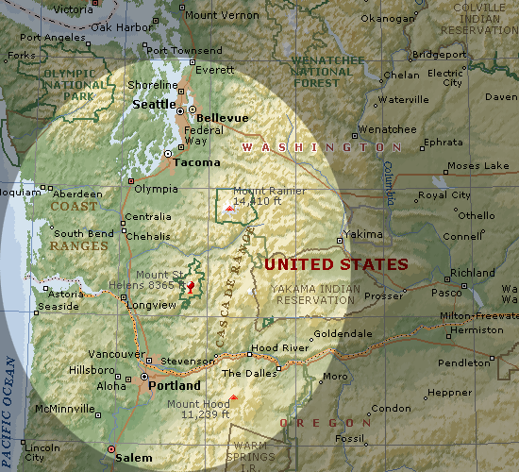
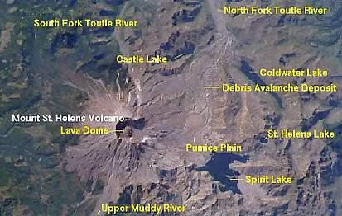
Mt. St. Helens

Slide 5
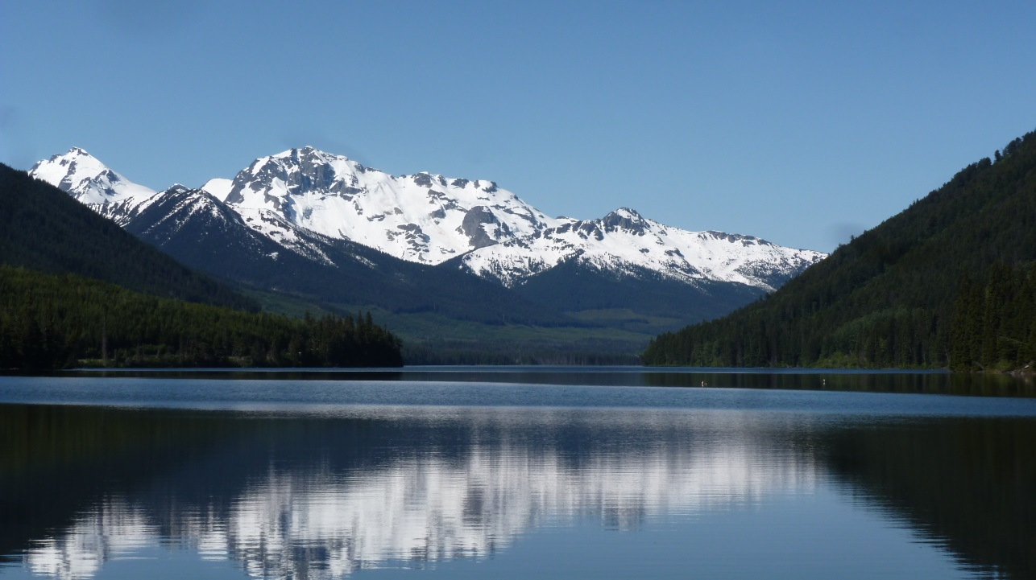
Mountains
Formed when two tectonic plates collide with one another
Two types of mountain building processes:
1) Folding 2) Faulting
Notes:
Start with sheet of paper in between two textbooks demonstrations; insert photo of mountains; play video of mountain formation

Slide 6
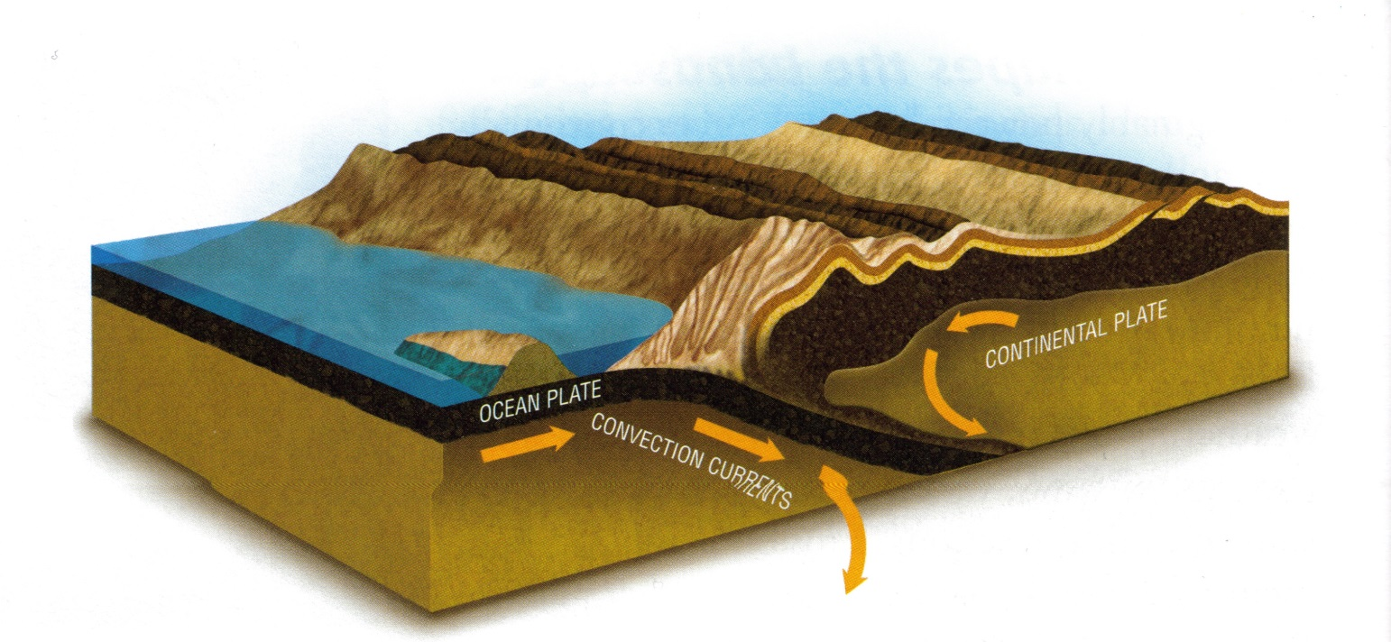
Fold Mountains
Fold mountains can be created by a process of subduction or uplift
Subduction occurs when two plates collide and one plate is forced downwards, while the other plate ‘scrunches’ upward
Notes:
Insert diagram of subduction, page 14, encounter canada

Slide 7
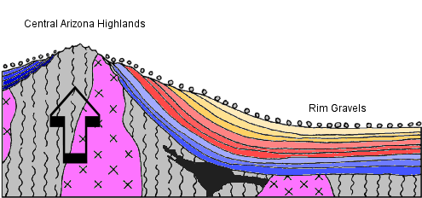
Fold Mountains
Uplift occurs when two plates push against each other and both are crumpled upwards
Notes:
Insert diagram of uplift

Slide 8
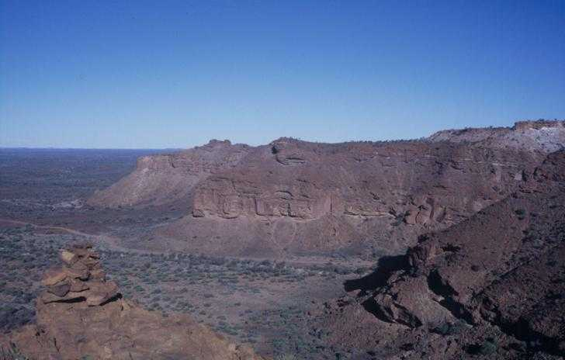
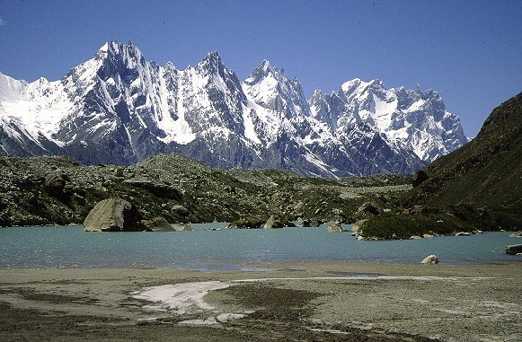
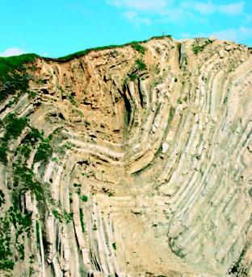
Notes:
Insert photos of fold mountains

Slide 9
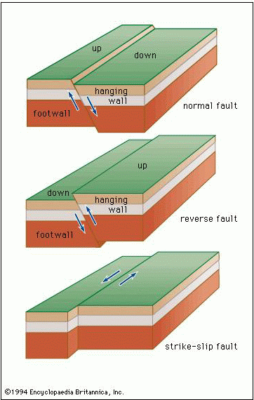
Faulting
Faulting is the movement of plates along a crack (fault) or cracks in the earth’s crust
There are three different types of faults: normal faults, reverse faults, and strike-slip faults

Slide 10
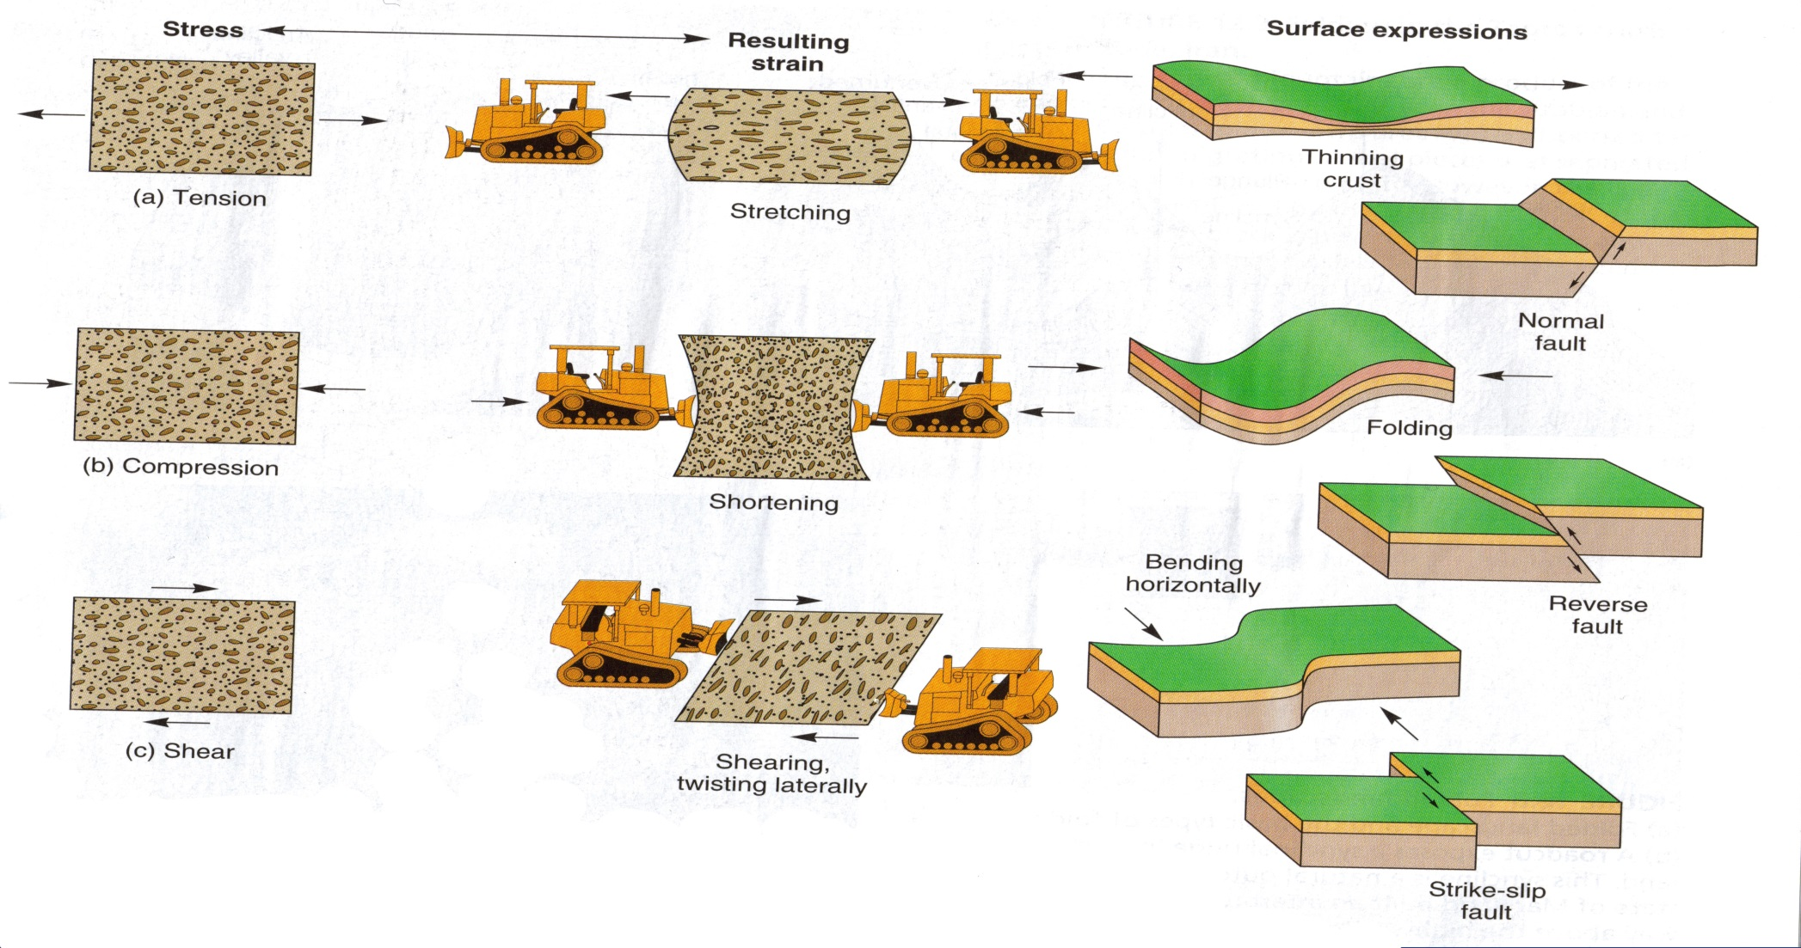
Faulting
Faulting occurs as a result of different types of stress and strain: tension, compression and shear
Notes:
Insert graphic, page 365 from geosystems

Slide 11
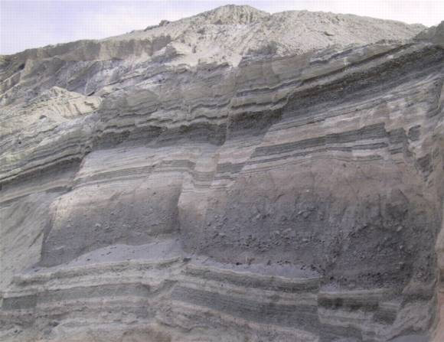
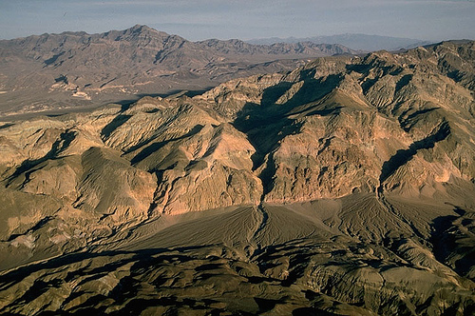
Faulting
Notes:
Insert other photo of fault

Slide 12
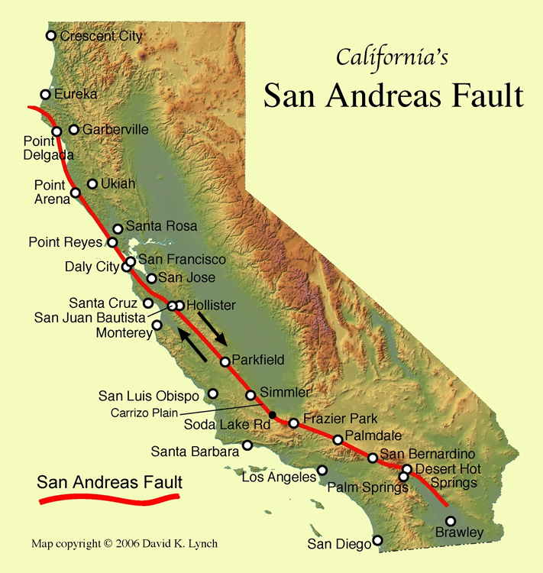
San Andreas Fault
One of the largest, most active faultines in the world
Responsible for most of California’s earthquakes

Slide 13
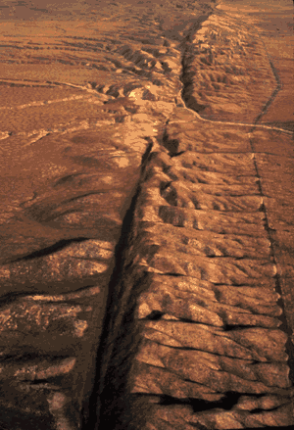
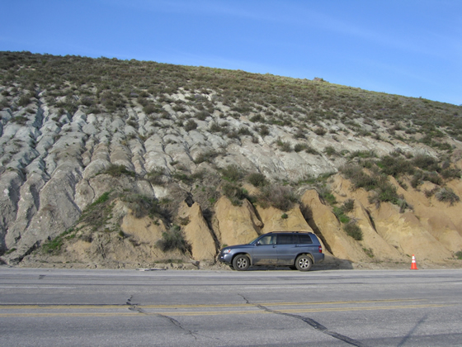
San Andreas Fault

